Slide 1
Comparaison expérimentale des algorithmes de chiffrement symétrique
Performance et robustesse : architecture x86 (Windows) vs ARM (Raspberry Pi)
INF1430 — Université TÉLUQ TN3 — Implémentation et expérimentation Melissa Moya
Notes:
Background: dark background (navy or near-black) — cryptography/tech aesthetic, also makes text pop
Accent image: a subtle split graphic — left side a CPU/chip (x86), right side a Raspberry Pi board, separated by a vs or a vertical dividing line
Optional: a faint binary/hex pattern in the background (not distracting, just texture)
Font: clean sans-serif (Calibri, Inter, or Montserrat) — nothing fancy, this is a technical presentation

Slide 2
Plan de la présentation
Nature du système & architecture
Protocole expérimental
Validation fonctionnelle (KAT)
Résultats de performance — débit par algorithme
Robustesse cryptographique — avalanche & sensibilité aux clés
Synthèse & recommandations
Notes:
Visual suggestions
Each item on its own line with a number or subtle icon (lock 🔒, chart 📊, etc. — but keep it minimal)
Highlight the current section as you progress through the presentation — either change the color of the active item or use a simple arrow/indicator. This keeps the audience oriented
No sub-bullets here — this is just the map, not the territory

Slide 3
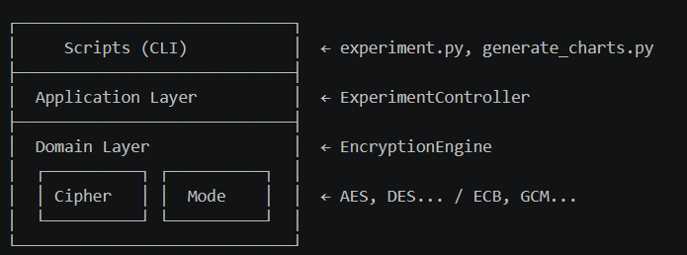
Nature du système
architecture diagram (layered, vertical):
Moteur expérimental — pas une application utilisateur
Aucune interface graphique : entrée = paramètres, sortie = CSV
Conçu pour isoler la variable matérielle entre plateformes
Link to video
La répétabilité est garantie par l'indépendance des primitives : PyCryptodome délègue aux mêmes routines C compilées sur les deux OS — les octets sont des octets.
Notes:
Slide 3 — Nature du système
Content
Slide title:
Nature du système
Left side — 3 key bullets (short, punchy):
Moteur expérimental — pas une application utilisateur
Aucune interface graphique : entrée = paramètres, sortie = CSV
Conçu pour isoler la variable matérielle entre plateformes
Right side — architecture diagram (layered, vertical):
Bottom banner — addresses FB1 directly (small text, highlighted box):
La répétabilité est garantie par l'indépendance des primitives : PyCryptodome délègue aux mêmes routines C compilées sur les deux OS — les octets sont des octets.
Video 1 cue
Put a small ▶ Vidéo 1 indicator in a corner of the slide. This is where you pause and play the video walkthrough of the repo in VS Code — showing the actual folder structure, opening EncryptionEngine.py, explaining the layer separation in your own words.
What NOT to put on it
Don't paste the full architecture text from the TN2 report — 3 bullets max
Don't explain every class — the video does that
The FB1 response should be visible but compact — one sentence in a callout box is enough
The diagram is the hero of this slide — it communicates the whole design at a glance.

Slide 4
Protocole expérimental
platform comparison table
 | Laptop x86 | Raspberry Pi
CPU | Intel/AMD x86-64 | ARM Cortex-A
OS | Windows 11 | Raspberry Pi OS
AES-NI | ✅ Oui | ❌ Non
RAM | ~16 GB | 4 GB
Contexte | Multitâche | Minimaliste
experiment parameters (3 bullets):
5 algorithmes : AES, DES, 3DES, Twofish, ChaCha20
Tailles de message : 64 B → 16 384 B (8 paliers)
n = 100 répétitions par configuration → CI95 = 1.96 × σ/√n
Bottom banner — addresses FB2 (callout box):
n = 100 a été choisi au seuil où l'IC à 95 % se stabilise — au-delà, le gain de précision est marginal par rapport au coût CPU.
Notes:
Slide 4 — Protocole expérimental
Content
Slide title:
Protocole expérimental
Top — platform comparison table (2 columns):
Laptop x86Raspberry PiCPUIntel/AMD x86-64ARM Cortex-AOSWindows 11Raspberry Pi OSAES-NI✅ Oui❌ NonRAM~16 GB4 GBContexteMultitâcheMinimaliste
Middle — experiment parameters (3 bullets):
5 algorithmes : AES, DES, 3DES, Twofish, ChaCha20
Tailles de message : 64 B → 16 384 B (8 paliers)
n = 100 répétitions par configuration → CI95 = 1.96 × σ/√n
Bottom banner — addresses FB2 (callout box):
n = 100 a été choisi au seuil où l'IC à 95 % se stabilise — au-delà, le gain de précision est marginal par rapport au coût CPU.
Visual suggestions
The AES-NI row in the table should be visually striking — green checkmark vs red X, this single difference explains the biggest result of the whole project
Put the CI95 formula in a small styled box — it signals statistical rigor without being overwhelming
If you have the CI95 convergence graph (showing the interval stabilizing around n=80-100), put it as a small inset chart in the bottom right corner
Video 2 cue
▶ Vidéo 2 indicator on this slide. The video shows experiment.py actually running in the terminal, the CSV appearing, and you explaining verbally what n=100 means and how you measured the confidence interval.
What NOT to put on it
Don't list every single message size — "64 B → 16 384 B (8 paliers)" is enough
Don't explain the full CI95 math on the slide — one formula, the rest is in the video
Don't put both platform photos AND the table — pick one visual anchor (the table wins)
This slide answers "how did you do it" before the audience sees any results. The AES-NI row in the table is the setup for the payoff on slide 8.

Slide 5
Pourquoi Python ?
Critère | Python | C++ | Java
Performance brute | ⚠️ Moyenne | ✅ Élevée | ⚠️ Moyenne
Biais d'optimisation | ✅ Faible | 🚨 Compilateur | 🚨 JIT/JVM
Reproductibilité inter-plateformes | ✅ Excellente | ⚠️ Variable | ⚠️ Variable
Accès aux primitives bas niveau | Via PyCryptodome (C natif) | ✅ Direct | ⚠️ Limité
Encodage des données | ✅ bytes bruts | ✅ Contrôlable | ⚠️ JVM dépendant
FB3 — Sur C++ : C++ aurait mesuré les optimisations du compilateur autant que les algorithmes. Notre objectif est de comparer les algorithmes entre plateformes, pas les compilateurs.
FB4 — Sur l'encodage : Les messages sont générés en bytes bruts via os.urandom() — aucune conversion str/unicode, aucun biais Linux/Windows possible.
Notes:
Visual suggestions
Color the Python column green — make it clear this is the justified winner
The two callout boxes should look like direct responses — maybe label them "Réponse au feedback prof" with a distinct color
Keep the table compact — 5 rows is the max before it gets hard to read on a slide
What NOT to put on it
No code snippets on this slide — the table makes the point
Don't over-defend Python — acknowledge C++'s advantage (raw performance), then pivot to why that's not what you were measuring
No video for this slide — it's short and self-explanatory
This slide is essentially a direct conversation with the teacher's feedback — acknowledge the critique, give the reasoned answer, move on.

Slide 6
Validation fonctionnelle — Known Answer Tests (KAT)
Avant toute mesure de performance : prouver que les implémentations sont correctes.
Algorithme | Mode | Vecteur NIST | Statut
AES-128 | ECB | NIST FIPS 197 | ✅ PASS
AES-256 | GCM | NIST SP 800-38D | ✅ PASS
DES | ECB | NIST SP 800-67 | ✅ PASS
3DES | ECB/CBC | NIST SP 800-67 | ✅ PASS
ChaCha20 | Stream | RFC 7539 | ✅ PASS
AES | CBC/CTR | NIST SP 800-38A | ✅ PASS
Toutes les implémentations produisent les sorties exactes attendues par les standards — les résultats de performance qui suivent sont fiables.
Notes:
Visual suggestions
Every row should be green with a checkmark — full pass, make it visually satisfying
The NIST reference column signals academic rigor without needing explanation
The bottom statement acts as a bridge to the results slides — it earns the right to present performance data
Video 3 cue
▶ Vidéo 3 on this slide. You run run_kat.py live in the terminal, the green PASS lines scroll by, and you explain what a KAT is in plain language — "I give the algorithm a known input, I check that the output matches exactly what NIST says it should be. If it doesn't match, every performance number after this is meaningless."
What NOT to put on it
Don't explain how KAT works in detail on the slide — that's the video's job
Don't add a FAIL row "for completeness" — there are none, don't invent drama
Don't list every single test vector — the reference column is enough
This slide is short but critical — it's the credibility gate. Everything after this is built on the fact that you proved correctness first.

Slide 7
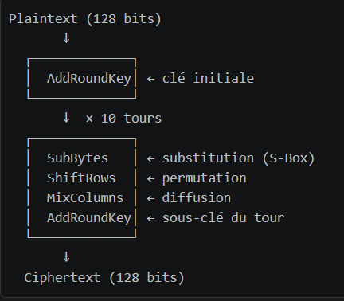
AES — Advanced Encryption Standard
4 key facts (bullets):
Chiffrement par blocs de 128 bits
Clés : 128 / 192 / 256 bits → 10, 12 ou 14 tours
Chaque tour : SubBytes → ShiftRows → MixColumns → AddRoundKey
Standard NIST depuis 2001 (Rijndael), universellement déployé
AES-NI callout box (highlighted, distinct color):
AES-NI (x86) Instructions matérielles Intel/AMD depuis 2010 1 tour AES = 1 cycle CPU → C'est pourquoi x86 est 5.58× plus rapide que le Pi
Notes:
Visual suggestions
The AES-NI box should visually "pop" — this is the key insight that connects the theory to your results, use a bright accent color (orange or gold)
The round diagram doesn't need to show all 10 tours — one iteration with "× 10" is cleaner
Keep the left bullets very short — the video goes deep, the slide stays light
Video 4 cue
▶ Vidéo 4 on this slide. This is your theory deep-dive — explain each of the 4 steps of a round in plain language, show what AES-NI actually is (a CPU instruction, not magic), and set up the "punchline" that the 5.58× gap on the next slide comes entirely from this one hardware feature.
What NOT to put on it
Don't show the actual S-Box lookup table — too dense for a slide
Don't explain GF(2⁸) Galois field math — one sentence max ("MixColumns mixes bytes using field arithmetic")
Don't put the results here — that's slide 8, keep theory and data separate
The AES-NI callout is the bridge between "here's how it works" and "here's why our numbers look the way they do.

Slide 8
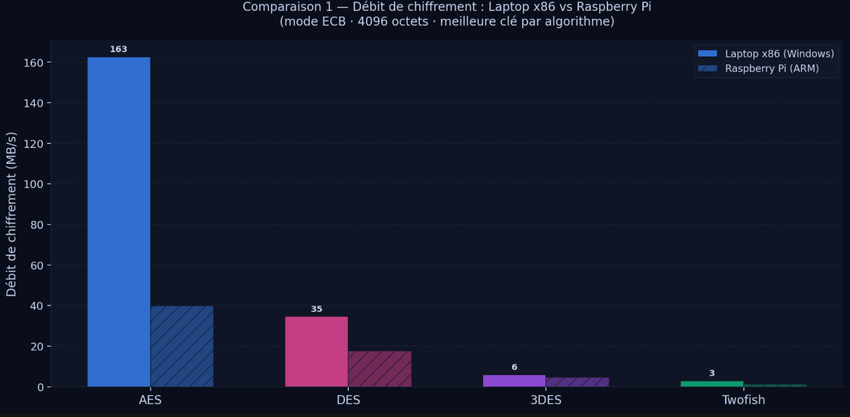
AES — Résultats expérimentaux
Notes:
Video 5 cue
▶ Vidéo 5 Walk through both charts — "look at how AES dominates on x86, now look at the ratio chart — 4.1× is not a normal CPU speed difference, that's a hardware instruction doing the work." Then explain the CBC story: why is encryption 10× slower than decryption on the same algorithm?
Slide 8a — AES : Débit global (cmp1)
Chart: cmp1_throughput_all.png — full width
3 bullet takeaways (right side or bottom strip):
AES x86 domine tout — 163 MB/s vs 74 MB/s sur Pi
ChaCha20 est 2ème sur x86 malgré l'absence d'accélération dédiée
Twofish et 3DES en queue — lents sur les deux plateformes
Bottom callout:
L'écart AES x86/Pi n'est pas dû à la vitesse du CPU — c'est AES-NI. (slide suivant)

Slide 9
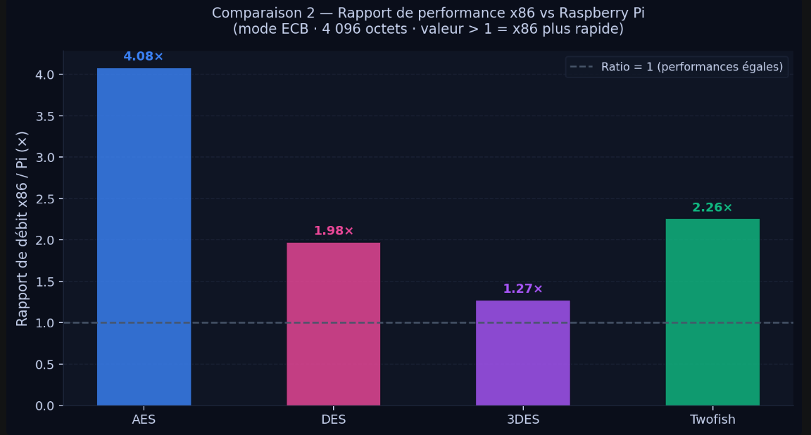
AES — Résultats expérimentaux
Notes:
Slide 8b — AES : L'écart x86/Pi expliqué (cmp2)
Chart: cmp2_speedup_ratio.png — full width
3 bullet takeaways:
AES = ratio 4.1× — le plus grand écart de tous les algorithmes
ChaCha20 = ratio 1.6× — presque équitable entre plateformes
3DES = ratio 1.27× — lent partout, rien à accélérer
Bottom callout (highlighted box):
AES-NI sur x86 = 1 tour complet en 1 cycle CPU. Sans ça, le Pi fait le même travail en logiciel pur → 4× plus lent.

Slide 10
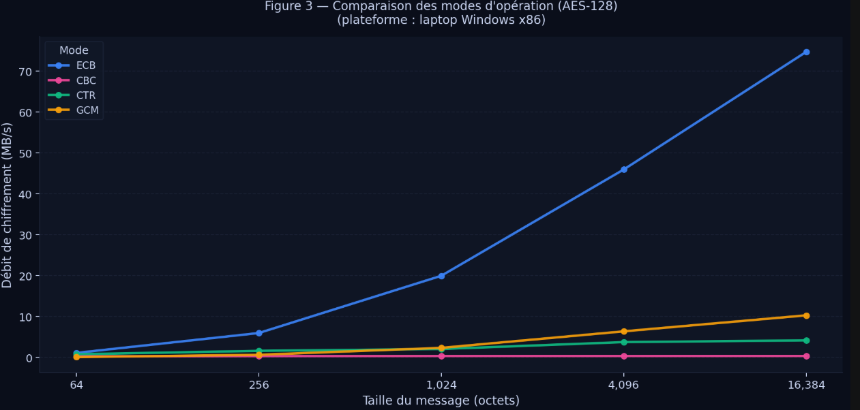
AES — Résultats expérimentaux
Notes:
Slide 8c — AES : Le piège des modes (fig3)
Chart: fig3_aes_mode_comparison.png — full width
3 bullet takeaways:
ECB = 162 MB/s mais cryptographiquement cassé (slide 12)
GCM = recommandation 2026 — confidentialité + authentification
CBC chiffrement = 0.73 MB/s — séquentiel, non parallélisable
Bottom callout (red/warning box):
CBC est 223× plus lent qu'ECB en chiffrement. Pression de performance → risque de régressions de sécurité chez les développeurs non avertis.

Slide 11
AES — Résultats expérimentaux
Mode | Chiffrement (MB/s) | Déchiffrement (MB/s) | Note
ECB | 162.78 | 184.09 | ⚠️ Rapide mais dangereux
GCM | 25.78 | 22.19 | ✅ Standard recommandé
CTR | 6.61 | 6.68 | ✅ Parallélisable
CBC* | 0.73 | 7.69 | 🚨 Chiffrement séquentiel
*CBC chiffrement = séquentiel (chaque bloc dépend du précédent) — 223× plus lent qu'ECB. Le déchiffrement, lui, est parallélisable → 7.69 MB/s.
AES sur x86 = 4.1× plus rapide que sur Pi → grâce à AES-NI exclusivement
ECB le plus rapide ≠ le plus sécurisé (slide 12 explique pourquoi)
CBC : piège de performance → risque réel de mauvaises décisions de sécurité

Slide 12
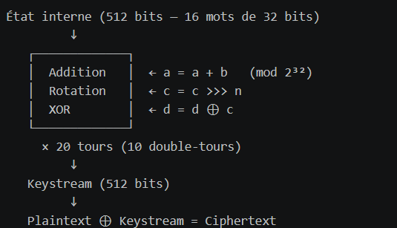
ChaCha20 — Conçu pour le logiciel pur
Notes:
Slide 9 — ChaCha20 : Comment ça marche
Content
Slide title:
ChaCha20 — Conçu pour le logiciel pur
Left side — 4 key facts (bullets):
Chiffrement de flux (stream cipher) — pas de blocs
Clé : 256 bits uniquement
Repose sur des opérations ARX : Addition, Rotation, XOR
Conçu par Daniel J. Bernstein en 2008 — optimisé pour ARM et x86 sans instructions dédiées
Center — ARX diagram (simple, visual):
Right side — contrast box vs AES:
AESChaCha20OpérationsS-Box (table lookup)ARX (opérations natives)Accélération HWAES-NI requisAucune nécessaireVulnérabilité cachePossible (timing)Constant-time par designARM performancePénalisé sans NINatif et efficace
Visual suggestion
The ARX box should be in your slide accent color with the 3 operations listed distinctly — this is the core concept, make it stand out
The contrast table makes the "why ChaCha20 exists" argument immediately clear — it was literally designed to fix AES's ARM problem
Video 6 cue
▶ Vidéo 6 on this slide. Explain in your own words: "AES needs a lookup table called the S-Box — on hardware without AES-NI, reading that table can leak timing information. ChaCha20 only uses add, rotate, XOR — every CPU does those in exactly one cycle, always the same time, no table needed. That's why it's the default on Android and in TLS 1.3 on mobile."
What NOT to put on it
Don't show the full 4×4 state matrix with hex values — too dense
Don't explain Poly1305 here — that's authentication, separate concern
Keep the ARX diagram simple — the concept is the point, not the full spec
The contrast table is the key visual — it answers "why does this algorithm exist?"

Slide 13
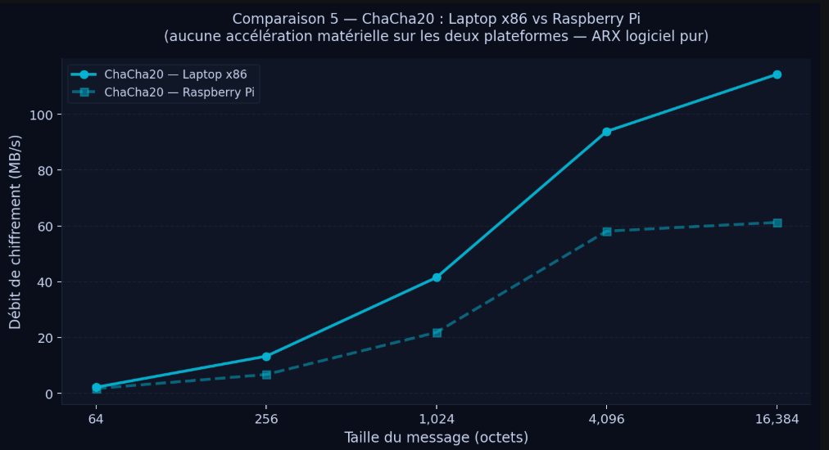
Notes:
Slide 10 — ChaCha20 : Résultats
Content
Slide title:
ChaCha20 — L'algorithme qui refuse l'inégalité des plateformes
Chart: cmp5_chacha20.png — large, centered, takes ~60% of the slide
3 bullet takeaways (below or beside chart):
x86 : 114 MB/s — Pi : 61 MB/s → ratio 1.87× seulement
Pour comparaison : AES a un ratio de 4.1× — ChaCha20 est 2× plus équitable
Les courbes convergent à partir de 4096 octets → le Pi exploite bien son pipeline ARM sur ARX
Bottom callout (highlighted box):
Sur Pi, ChaCha20 (61 MB/s) surpasse AES-GCM sur Pi (6.4 MB/s) par un facteur 9.5× — pour tout déploiement IoT ou mobile, ChaCha20 est le choix évident.
Visual suggestion
Annotate directly on the chart the 1.87× gap with an arrow between the two lines at the rightmost data point
Add a small badge: "TLS 1.3 sur mobile = ChaCha20-Poly1305" — connects the academic result to real-world practice
Video 7 cue
▶ Vidéo 7 on this slide. "Look at this chart — the gap between x86 and Pi barely opens compared to AES. This is by design. Bernstein built this for exactly this situation — a world where not every device has dedicated crypto hardware. That's why your Android phone and every TLS 1.3 connection on mobile uses ChaCha20."
What NOT to put on it
Don't compare raw MB/s numbers against AES-ECB directly — ECB is unfair since it has no authentication
Don't mention Poly1305 unless you have a dedicated slide for it — keep focus on ChaCha20 performance
Don't put both cmp3 and cmp5 — cmp5 is more focused and cleaner for this story
The "9.5× faster than AES-GCM on Pi" callout is the punchline — it reframes ChaCha20 not as a weak alternative to AES but as the dominant choice on ARM.

Slide 14
Notes:
Slide 11 — DES / 3DES / Twofish : Les perdants
Content
Slide title:
DES, 3DES, Twofish — Pourquoi ils ont perdu
Main element — 3-column layout, one per algorithm:
DES 🔴
40.7 MB/s (x86) / 18.3 MB/s (Pi)
Clé : 56 bits effectifs
Cassé en 22 heures en 1998 (EFF DES Cracker)
Aucune accélération matérielle nulle part
Verdict : mort depuis 1998, présent pour comparaison historique
3DES 🟠
12.3 MB/s (x86) / 7.5 MB/s (Pi)
Triple application de DES → 3× plus lent
Sécurité effective : 112 bits — coût : 3 passes séquentielles
Déprécié NIST 2017, interdit nouveaux systèmes 2023
Verdict : le pire des deux mondes — lent ET faiblement sécurisé
Twofish 🟢
2.82 MB/s (x86) / 1.29 MB/s (Pi)
Finaliste AES Contest 1998 — perdu contre Rijndael
Key schedule complexe, MDS matrices, permutations dépendantes de la clé
AES est 147× plus rapide sur x86
Verdict : trop complexe, jamais adopté industriellement
Visual suggestion
Each column gets a colored header matching the algorithm's chart color (pink for DES, purple for 3DES, green for Twofish)
Add a small red/orange warning badge under each: "⚠️ Déprécié", "🚨 Interdit", "❌ Obsolète"
Keep the performance numbers big and visible — 2.82 MB/s for Twofish is shocking next to 163 MB/s for AES
Video 8 cue
▶ Vidéo 8 on this slide. Keep it punchy: "DES — dead since 1998, your laptop can brute force it in hours. 3DES — they tried to fix it by running it three times, now it's three times slower and still not good enough. Twofish — fascinating algorithm, lost the AES competition fair and square, 147 times slower than the winner. These are here so we understand why AES won."
What NOT to put on it
Don't go deep on the cryptanalysis of each — one sentence verdict per algo is enough
Don't show all the mode comparisons for these — ECB only, the story is simple
Don't apologize for including them — they're essential historical context and make AES's dominance legible
Three algorithms, three verdicts, one slide. The contrast with AES (163 MB/s) vs Twofish (2.82 MB/s) makes the point without needing explanation.

Slide 15
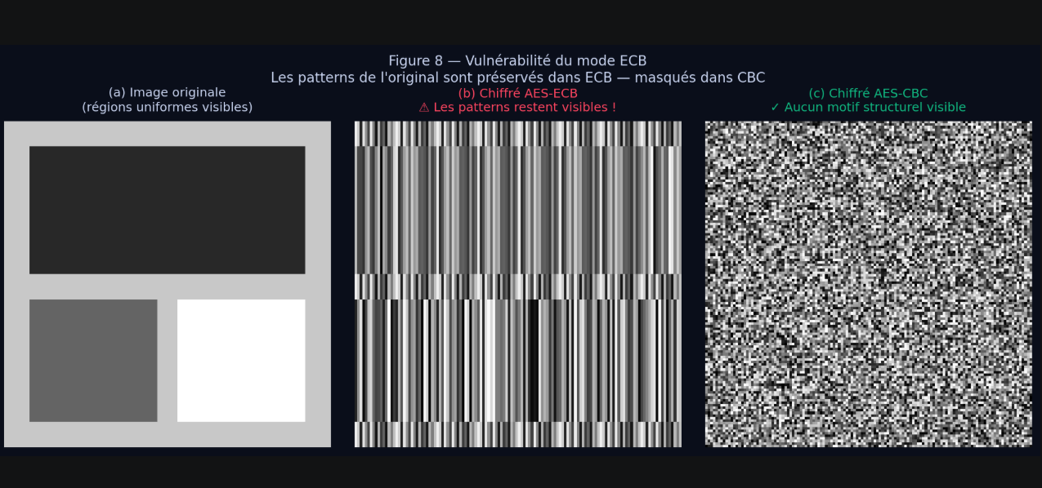
Notes:
Slide 12 — Vulnérabilité ECB
Content
Slide title:
ECB — Le mode le plus rapide est le plus dangereux
Chart: fig8_ecb_vulnerability.png — full width, this IS the slide
3 bullet takeaways (below the image):
ECB chiffre chaque bloc indépendamment avec la même clé
Deux blocs de plaintext identiques → deux blocs de ciphertext identiques
Les patterns structurels survivent au chiffrement → un observateur peut inférer le contenu sans jamais casser la clé
Bottom callout (red warning box):
ECB = 162 MB/s — le résultat le plus élevé du benchmark. C'est aussi le seul mode cryptographiquement cassé. Optimiser sans comprendre la sécurité est une faute professionnelle.
Video 9 cue
▶ Vidéo 9 on this slide. Run ecb_visual_vulnerability.py live in the terminal, watch the image appear, then explain: "Every block of identical pixels encrypts to the same ciphertext block. You don't need to break the key — the structure of the data is still visible. This is why ECB is banned in any serious security context."
What NOT to put on it
Don't explain how to fix ECB — that's already covered in the modes slide (8c)
Don't put performance numbers here — the point is purely about security, not speed
Let the image do the talking — minimize text, maximize visual
The three-panel image is self-explanatory — original shapes → ECB stripes (structure preserved) → CBC noise (properly hidden).

Slide 16
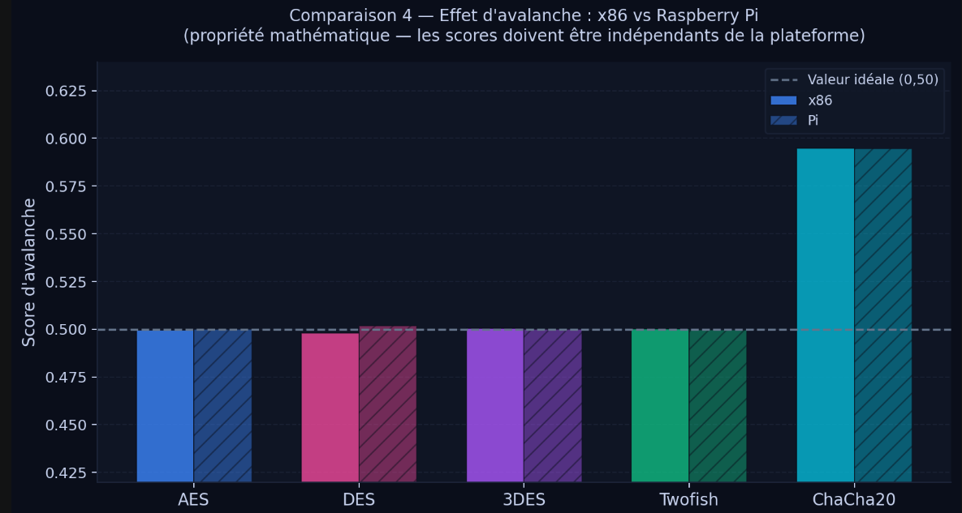
Notes:
Slide 13 — Effet d'avalanche
Content
Slide title:
Effet d'avalanche — La santé cryptographique des algorithmes
Left side — what is it? (2 bullets):
Modifier 1 bit en entrée doit changer ~50% des bits en sortie
Idéal = 0.500 — trop bas = diffusion faible, trop haut = anomalie de mesure
Center — chart: cmp4_avalanche.png — large
Right side — verdict table:
AlgorithmeScoreVerdictAES0.4997✅ Parfait3DES0.5004✅ ExcellentTwofish0.5004✅ ExcellentDES0.4982✅ AcceptableChaCha200.5948⚠️ Anomalie
Bottom callout (amber box — for ChaCha20):
ChaCha20 à 0.594 n'est pas une faille — c'est une limite de méthodologie. L'avalanche mesure la diffusion d'un chiffrement par blocs. ChaCha20 est un chiffrement de flux : son keystream est calculé indépendamment du plaintext, le XOR final produit un score naturellement plus élevé. La métrique n'est pas directement transposable.
Visual suggestion
The 0.500 dashed reference line on the chart is the hero — everything should cluster around it except ChaCha20
ChaCha20's bar sticking above the others is instantly visible and creates a natural "wait, what?" moment for the audience — let it breathe, then explain it
Color the ChaCha20 row in the table amber/yellow to match the callout
Video 10 cue
▶ Vidéo 10 on this slide. "Imagine you have a locked box — you change one digit of the combination. Does the inside look completely different? That's what we're measuring. For AES, changing one input bit scrambles exactly half the output bits — the mathematical ideal. DES is close. Then there's ChaCha20 at 0.594 — but that's not a flaw, it's a measurement mismatch."
What NOT to put on it
Don't put the key avalanche (fig4b) here — that's the next slide
Don't dismiss ChaCha20's score without explaining why — the audience will spot it and wonder
Don't show raw per-configuration numbers — the averaged chart tells the story cleanly
The ChaCha20 anomaly is the most interesting moment on this slide — it looks like a problem but it's actually a lesson about measurement methodology.

Slide 17
Notes:
Slide 14 — Sensibilité aux clés
Content
Slide title:
Sensibilité aux clés — Quand changer un bit de clé ne suffit pas
Left side — what is it? (2 bullets):
Modifier 1 bit de la clé doit aussi changer ~50% des bits en sortie
Mesure la qualité du key schedule — la façon dont la clé est étendue en sous-clés
Center — chart: fig4b_key_avalanche.png — large
Right side — verdict table:
AlgorithmeScore cléVerdictAES0.5007✅ ParfaitTwofish0.5005✅ ExcellentChaCha200.5927⚠️ Voir slide 13DES0.4396🚨 Faible3DES0.4410🚨 Faible (hérité)
Bottom callout (red warning box):
DES à 0.439 — ce n'est pas un artefact. 64 clés "faibles" et "semi-faibles" documentées depuis les années 90 produisent des sorties structurellement moins aléatoires. Une app qui génère des clés DES sans vérifier ces cas est vulnérable. 3DES hérite directement de ce problème.
Visual suggestion
The DES and 3DES bars dropping below 0.5 should be visually striking — annotate them directly on the chart with "0.44" in red
The contrast between AES (0.500, perfect) and DES (0.439, structural weakness) is the whole point of this slide
The bar chart already has both plaintext-flip and key-flip side by side — that visual comparison is the story
What NOT to put on it
Don't re-explain the ChaCha20 anomaly — just reference slide 13 briefly
Don't go into Feistel network internals or DES key schedule math — one sentence is enough
Don't conflate this with the avalanche slide — key sensitivity and plaintext diffusion are different properties, the audience should leave knowing the difference
The DES 0.439 is the punchline — it's not just slow and cryptographically weak, its key schedule is also structurally deficient.

Slide 18
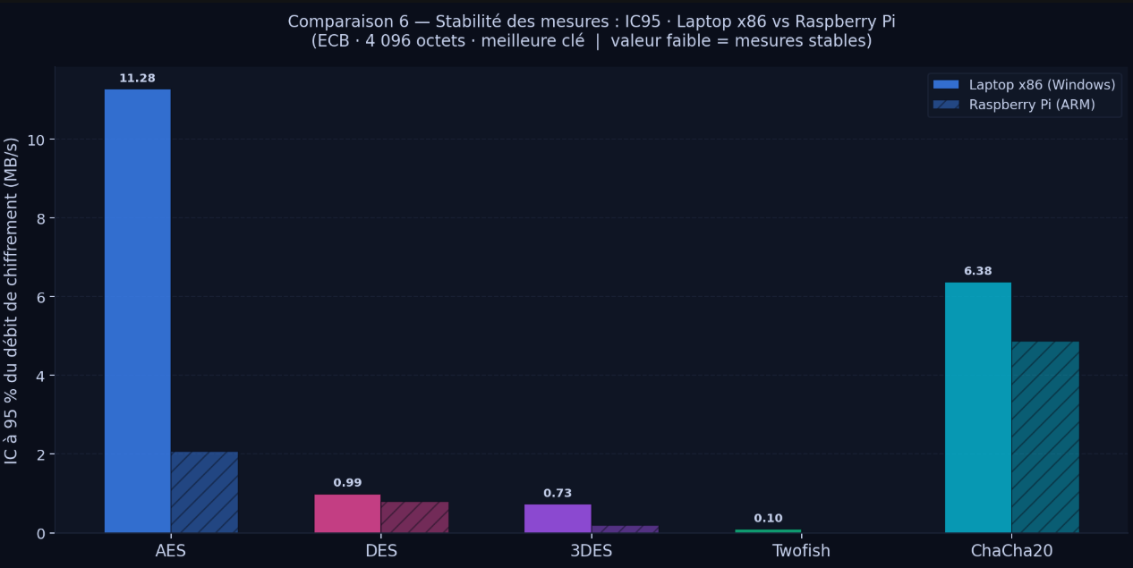
Notes:
Slide 15 — Stabilité des mesures (CI95)
Content
Slide title:
Stabilité — Le Raspberry Pi plus fiable que le laptop ?
Chart: cmp6_ci95_stability.png — large, centered
3 bullet takeaways:
AES sur x86 : CI95 = 11.28 MB/s — le Pi pour le même algo : 2.0 MB/s → le laptop est 5.6× plus erratique
Twofish : CI95 ≈ 0 sur les deux — stable car trop lent pour que le bruit CPU soit perceptible
ChaCha20 : variable sur les deux plateformes — ARX sans matériel dédié = sensible au scheduler OS
Bottom callout (highlighted box — counter-intuitive result):
Windows 11 sur x86 = Turbo Boost variable, processus en background, caches L3 partagés. Le Pi sous Raspberry Pi OS est déterministe par nature. Pour un protocole temps-réel ou un HSM, la stabilité compte autant que le débit brut.
Video 11 cue
▶ Vidéo 11 on this slide. "This is the most surprising result in the whole project. Your laptop is faster — but look at AES: the confidence interval on x86 is 11 MB/s wide. On the Pi it's 2. Your laptop is running 40 browser tabs, a Spotify process, Windows Update in the background. The Pi runs nothing. For anything where latency must be predictable — think real-time systems, industrial controllers — the Pi is actually the better platform."
What NOT to put on it
Don't explain what CI95 means mathematically here — that was slide 4 (protocole expérimental)
Don't frame this as "the Pi is better" — the nuance is predictability vs raw speed, two different use cases
Twofish's near-zero CI95 is a trap — mention it briefly: stable because slow, not because good

Slide 19
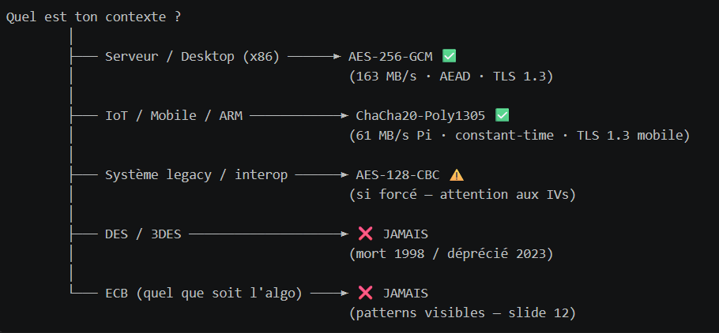
Notes:
Slide 16 — Synthèse & Recommandations
Content
Slide title:
Synthèse — Quel algorithme choisir en 2026 ?
Main element — decision flowchart (vertical or branching):
Right side — quick reference table:
ContexteAlgorithmeModeRaisonServeur web, cloudAES-256GCMAEAD, NIST, TLS 1.3IoT, Android, ARMChaCha20Poly1305ARX, constant-timeDonnées en masseAES-256CTRParallélisableÀ éviterDES, 3DES—Déprécié / casséInterditTout algoECBPatterns visibles
Visual suggestion
The flowchart should be the centerpiece — use your slide accent colors (blue for AES, cyan for ChaCha20, red for the two "NEVER" branches)
The "NEVER" branches should visually stand out — red color, bold, maybe a small ❌ icon
Connect this to the literature: add a small footnote "Recommandations conformes à NIST SP 800-175B et RFC 8446 (TLS 1.3)" — this addresses FB5 (Stallings comparison)
Video 12 cue
▶ Vidéo 12 on this slide. "If you take one thing from this presentation: AES-GCM on x86, ChaCha20 on ARM. Never ECB regardless of algorithm, never DES or 3DES in new code. Everything else in this project was the empirical proof that leads to exactly these four lines."
What NOT to put on it
Don't rehash the numbers — they've all been shown, this slide is the conclusion
Don't add new algorithms not in the study
Don't hedge — make the recommendations clear and direct, the data supports them

Slide 20
Notes:
Slide 17 — Conclusion & TN4
Content
Slide title:
Conclusion — Ce qui a été livré, ce qui vient ensuite
Left side — Ce qui est livré (TN3) ✅
5 algorithmes implémentés et validés (KAT NIST)
4 modes d'opération (ECB, CBC, CTR, GCM) + Stream
Expérimentations sur 2 plateformes : x86 Windows + Raspberry Pi ARM
~600 mesures de débit collectées (n=100 par configuration)
Analyse : avalanche, sensibilité aux clés, stabilité CI95, vulnérabilité ECB
Right side — Ce qui vient en TN4 🔜
Analyse approfondie des hypothèses de recherche
Comparaison avec la littérature (Stallings, NIST SP 800-175B)
Rapport final — interprétation complète des résultats
Conclusions sur les choix architecturaux et recommandations formelles
Bottom — closing statement (large, centered, italic):
Les données parlent d'elles-mêmes : le choix d'un algorithme de chiffrement n'est pas qu'une décision de sécurité — c'est une décision d'architecture, de plateforme, et de contexte d'utilisation.
Visual suggestion
Two-column layout — left in green (done), right in blue (coming)
Use a simple timeline or checklist visual — TN1 → TN2 → TN3 → TN4, with TN3 highlighted
Keep it clean and short — this is the last slide before Q&A
Last element — bottom strip:
Merci · Questions ? [Your name] · INF1430 · Université TÉLUQ · 2026
What NOT to put on it
Don't summarize every result again — one sentence per section max
Don't put new data or charts — nothing new here
Don't end on "that's it" — end on the closing statement, it gives the work meaning

